Slide 1

Synthisizing $TiB_{2}$ Nanorods
Name: A.K. Gokul Raman
Discipline: Chemical Engineering
Supervisor: Dr. Kabeer Jasuja
Notes:
I am Gokul and I am doing project about synthesizing tib2 nanorods under Kabeer Sir

Slide 2
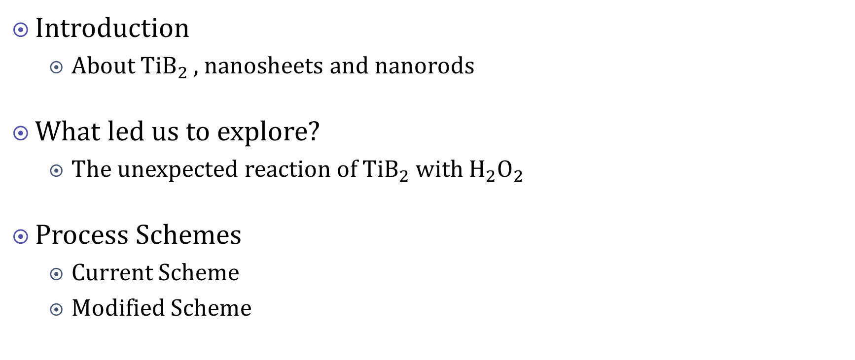
Outline of the Presentation
Introduction
About $TiB_{2}$ , nanosheets and nanorods
What led us to explore?
The unexpected reaction of $TiB_{2}$ with $H_{2}O_{2}$
Process Schemes
Current Scheme
Modified Scheme
Notes:
These are the following topics which I will be covering in this presentation. Short introduction about titanium diboride is followed by the line of thought for this project. Followed by the schemes which were followed or will follow for this project

Slide 3
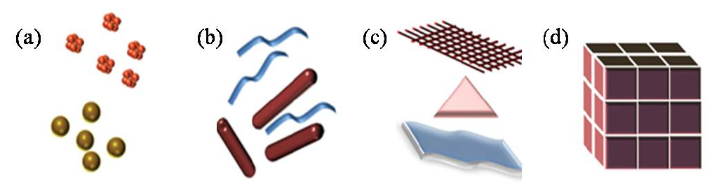
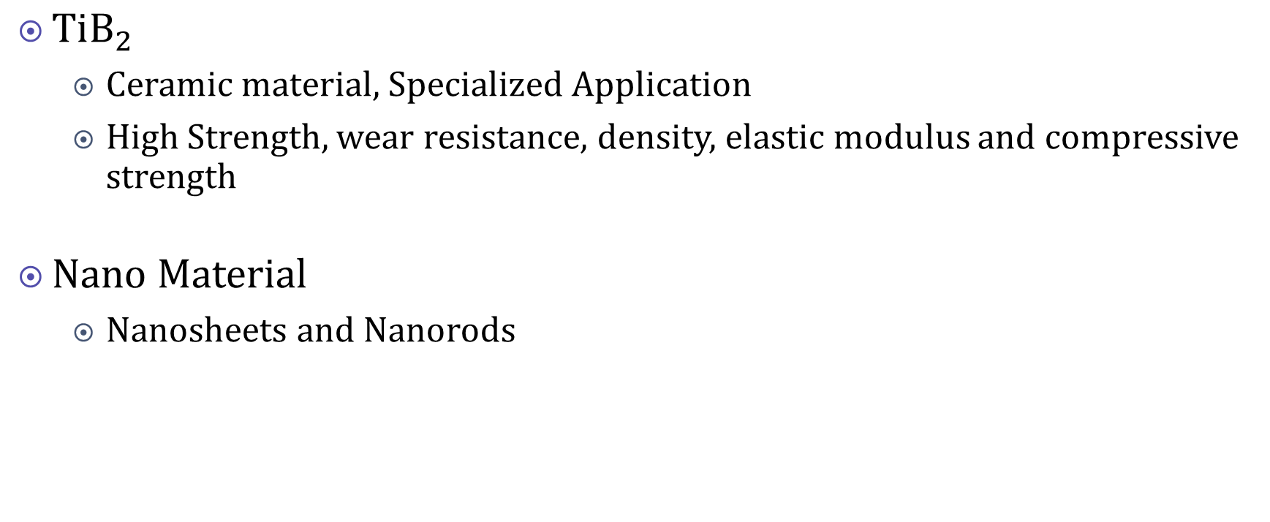
Introduction
$TiB_{2}$
Ceramic material, Specialized Application
High Strength, wear resistance, density, elastic modulus and compressive strength
Nano Material
Nanosheets and Nanorods
Ronald G. Munro; Material Properties of Titanium Diboride; J. Res. Natl. Inst. Stand. Technol. 105, 709-720 (2000)
A, Alagarasi; Chapter - INTRODUCTION TO NANOMATERIALS(2011).
Notes:
It is a well known ceramic material used in limited but specialized application. Some include resistant armor, cutting tools.
Also hypothesized to be applicable in TiB2 cathodes i.e., cell reactions like SHE.
It is attributed to their chemical and material nature. High Strength, wear resistance, density, elastic modulus and compressive strength
Coming to nanomaterial they are set of substances where at least one dimension is less than 100nm. At his scale unique properties of optical, magnetic, electrical and other property emerge.
They are classified based on the dimension and they are 0D, 1D, 2D, 3D. 0D for nano spheres, 1D for nanorods, 2D for nanosheets
We are interested in nanorods

Slide 4
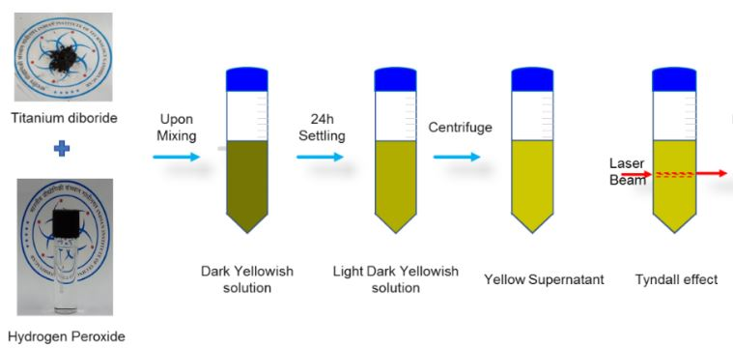


$$Unexpected TiB_{2} reaction with H_{2}O_{2}$$
$TiB_{2} uniqueness$
Unreactive
Reactive with $H_{2}O_{2},$mild
Derivatives of the reaction
Aim and Expected Outcome
Synthesis of $TiB_{2} nanorods$ from the reaction
From MTech thesis of Manis Lenka
Notes:
One more ting unique about TiB2 is their chemical property. They are mostly inert and react at only higher temperatures.
So it was not feasible to make them react with any compound. Due to which nanomaterial formation was difficult.
Then there was a accidental discovery about its reaction with h2o2 even in mild concentration by Manis. This is shown by color change.
Upon reaction they formed tib2 nanosheets which was completely unexpected. This is shown by Tindall effect because nanosheets itself is colloidal in nature.
Hypothesized mechanism is that, upon reacting with h202, tib2 breaks into smaller nucleuses or called seeds which then aggregate to form nanosheets
So our thought process is that, is it possible to make nanorods in this line of thinking

Slide 5
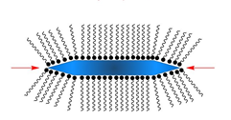

Introduction to Surfactant
Formation of nanomaterial
Seed formation
As Capping agent
How it helps in making Nanorods?
CTAB
McCarthy, S.A., Ratkic, R., Purcell-Milton, F. et al. Adaptable surfactant-mediated method for the preparation of anisotropic metal chalcogenide nanomaterials. Sci Rep 8, 2860 (2018).
Notes:
Based on our thought process, if we were able to arrest all sides of seed except one, we will be able to obtain nanorods. This is where surfactants play its role. Apt Surfactants when dissolved in the solution, it arrests the expansion of nucleus or seed from all sides except one. Thus surfactants are also called capping agents. One of the most widely used surfactant is CTAB and we have also used CTAB in our nanorod formation.

Slide 6
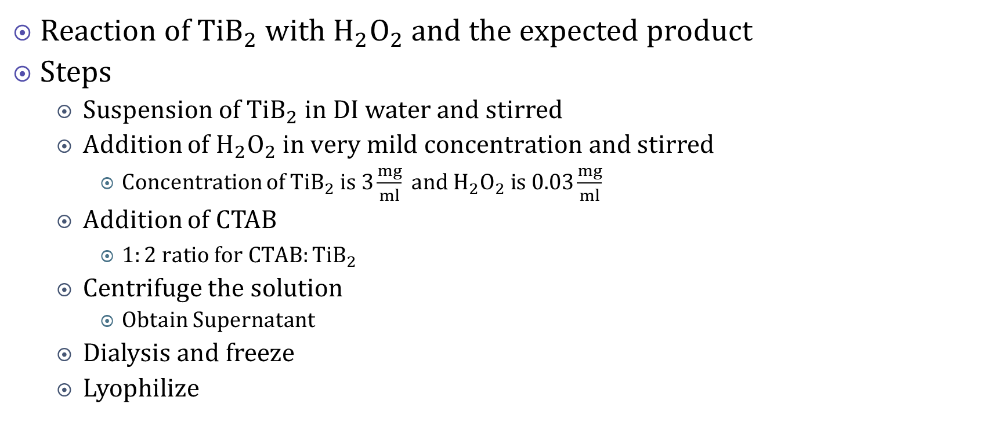
Process Scheme(current)
Reaction of $TiB_{2} with H_{2}O_{2} and the expected product$
Steps
Suspension of $TiB_{2} in DI water$ and stirred
Addition of $H_{2}O_{2} in very mild concentration$ and stirred
Concentration of $TiB_{2} is 3\frac{mg}{ml} and H_{2}O_{2} is 0.03\frac{mg}{ml}$
Addition of CTAB
$1:2 ratio for CTAB:TiB_{2}$
Centrifuge the solution
Obtain Supernatant
Dialysis and freeze
Lyophilize

Slide 7




Scheme
Froth formation
Supernatant separated out
$$H_{2}O_{2} 30\% 10 ml$$
CTAB 150 mg
Centrifugation
Aqueous $TiB_{2}$ Solution $300mg$
$per 90ml$
Reaction occurred
Seed Formation
$$CTAB+H_{2}O_{2}+TiB_{2} Solution$$
Dialysis
Lyophilize
Optical microscopy and FESEM analysis
Notes:
Froath formation might be due to surfactants. But not sure.

Slide 8
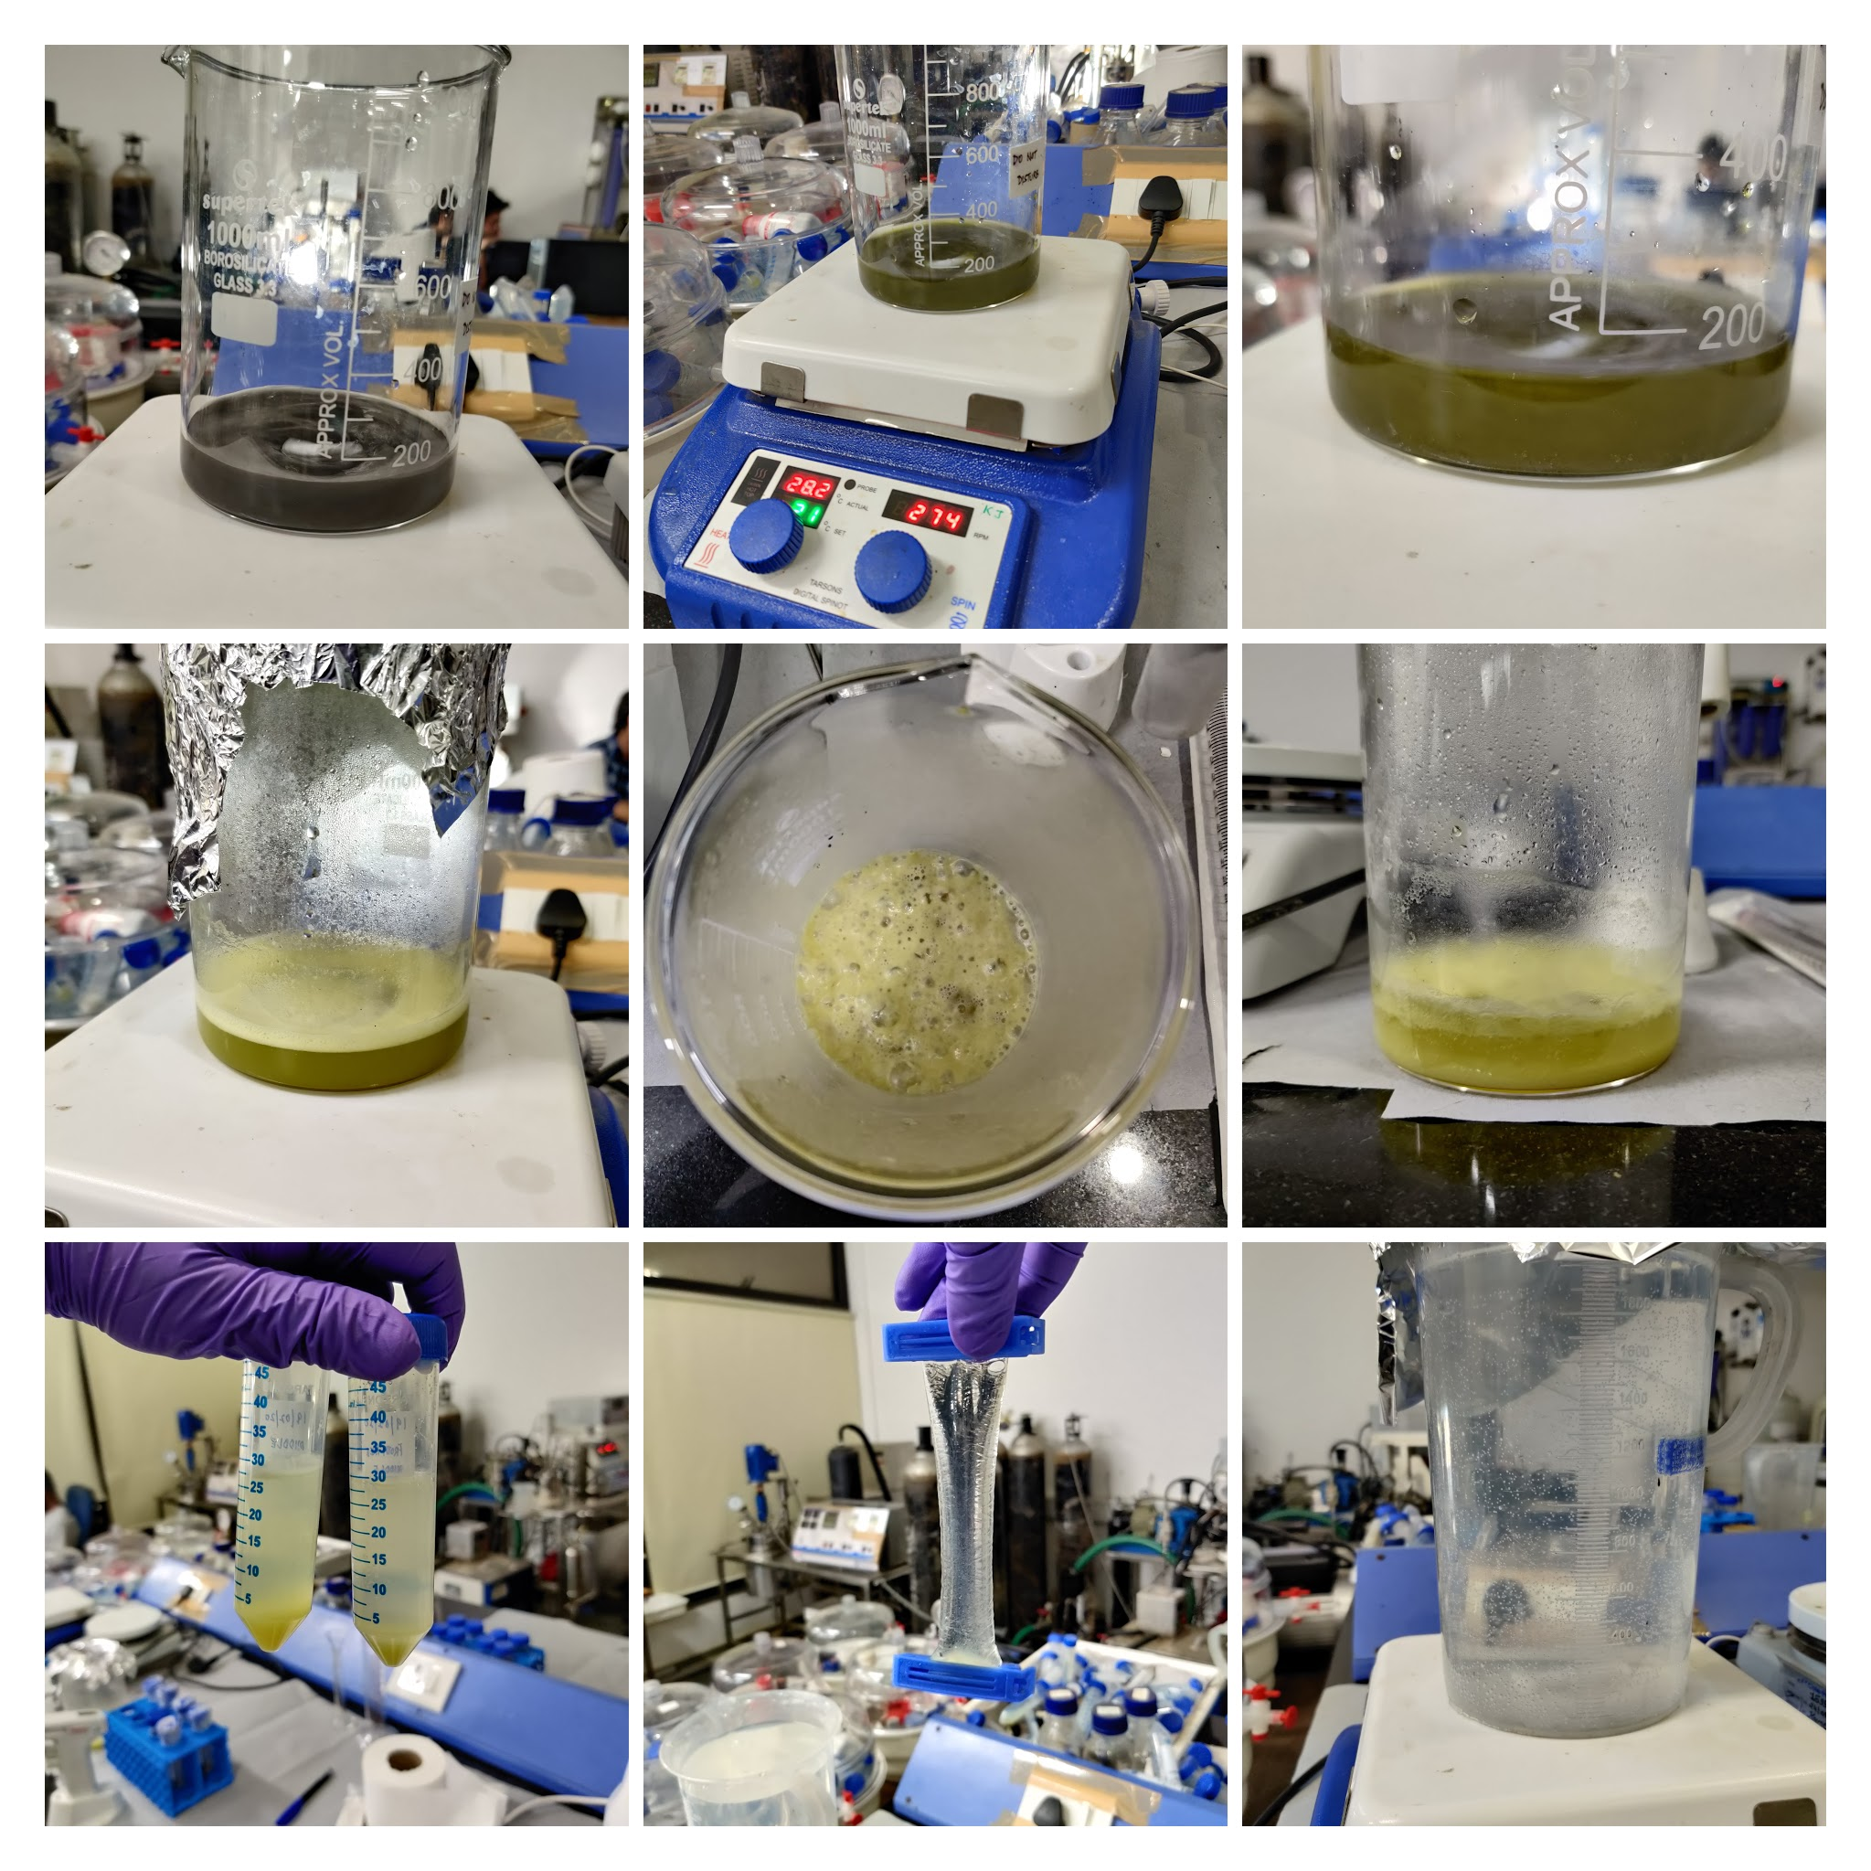

Slide 9
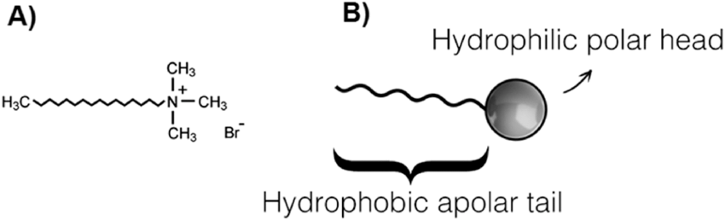

Why CTAB?
Gold nanorods formation
Vastly used over as surfactant
CTAB reacts with $H_{2}O_{2}$
Vahidi, K. & Jalili, Y. & Elahi, A.. (2017). The effect of varying the introduction mode of reactants on electrical, physical and thermal stability properties of polypyrrole synthesized with CTAB. AIP Advances. 7. 105222. 10.1063/1.4998727.
Bijoli Mondal, Asok Adak & Pallab Datta (2017): Effect of Operating Conditions and Interfering Substances on Photochemical Degradation of a Cationic Surfactant, Environmental Technology, DOI: 10.1080/09593330.2017.1365943
Notes:
Out of all the surfactants why only CTAB?. Though there is no exact answer to the logical question, we witness it been used widely in making gold nanorods and this motivated us to pursue with CTAB. Only after many days after the devised scheme, that there came a paper regarding CTAB reacting with H2O2. so in our previous scheme, there might be chances that, CTAB without being a surfactant could be reacting with H2O2. Thus alternate mechanism or scheme is required.

Slide 10
Alternative Scheme
Reaction with $H_{2}O_{2}$
Reaction with H_2 O_2
Centrifugation
Addition of CTAB
Lyophilize
Dialysis
Notes:
The scheme is not yet tested.

Slide 11
Plans Ahead
Characterization
Rational way of Selecting Surfactants
Analyze with various surfactants with varying concentration
Notes:
Rational way of selecting solvents/surfactants

Slide 12
References
Bijoli Mondal, Asok Adak & Pallab Datta (2017): Effect of Operating Conditionsand Interfering Substances on Photochemical Degradation of a Cationic Surfactant, Environmental Technology, DOI: 10.1080/09593330.2017.1365943
Ronald G. Munro; Material Properties of Titanium Diboride; J. Res. Natl. Inst. Stand. Technol. 105, 709-720 (2000) A, Alagarasi; Chapter - INTRODUCTION TO NANOMATERIALS(2011).
McCarthy, S.A., Ratkic, R., Purcell-Milton, F. et al. Adaptable surfactant-mediated method for the preparation of anisotropic metal chalcogenide nanomaterials. Sci Rep 8, 2860 (2018).
Salwa M.I. Morsy. Role of Surfactants in Nanotechnology and Their Applications. ISSN: 2319-7706 Volume 3 Number 5 (2014) pp. 237-260
Ashleigh D. Smith McWilliams, Carlos A. de los Reyes, Lucy Liberman, Selin Erg¨ulen, Yeshayahu Talmon, Matteo Pasquali acdfand Angel A. Mart. Surfactant-assisted individualization and dispersion of boron nitride nanotubes. Nanoscale Adv., 2019, 1, 1096
Alsultan Abdulkareem Ghassan, Nurul-Asikin Mijan,Yun Hin Taufiq-Yap. Nanomaterials: An Overview of Nanorods Synthesis and Optimization. 10.5772/intechopen.84550
L. P. Singh, S. K. Bhattacharyya, G. Mishra, S. Ahalawat. Functional role of cationic surfactant to control the nano size of silica powder. Appl Nanosci (2011) 1:117–122
Zia Ul Haq, Noor Rehman, Farman Ali, Nasir Mehmood Khan, Hidayat Ullah. Physico-chemical properties of cationic surfactant cetyltrimethylammonium bromide in the presence of electrolyte. Journal of Materials and Environmental Sciences ISSN : 2028-2508
M.Tech Thesis of Manis Lenka(2019-20)

